Slide 1
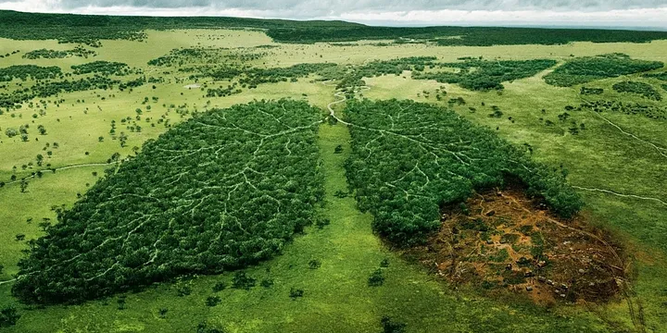

Global Air Quality
Southern Methodist University
Data Science Bootcamp
Project 3

Slide 2

Team 2 Members
Misha Borunda
Damarje Brown
Kimberly Childers
Jason Cisneros
Raheem Yusuff

Slide 3

Background
According to the World Health Organization (WHO), air pollution is one of the greatest environmental risks to health that affects everyone.
Outdoor air pollution in both cities and rural areas was estimated to cause 4.2 million premature deaths worldwide per year in 2019; this mortality is due to exposure to fine particulate matter, which causes cardiovascular and respiratory disease, and cancers.
Addressing air pollution, which is the second highest risk factor for noncommunicable diseases, is key to protecting public health.
Most sources of outdoor air pollution are well beyond the control of the vast majority, and this demands concerted action by local, national and regional level policy-makers working in sectors like energy, transport, waste management, urban planning and agriculture.

Slide 4
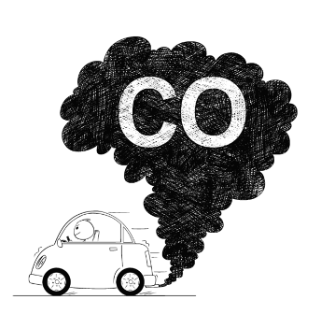
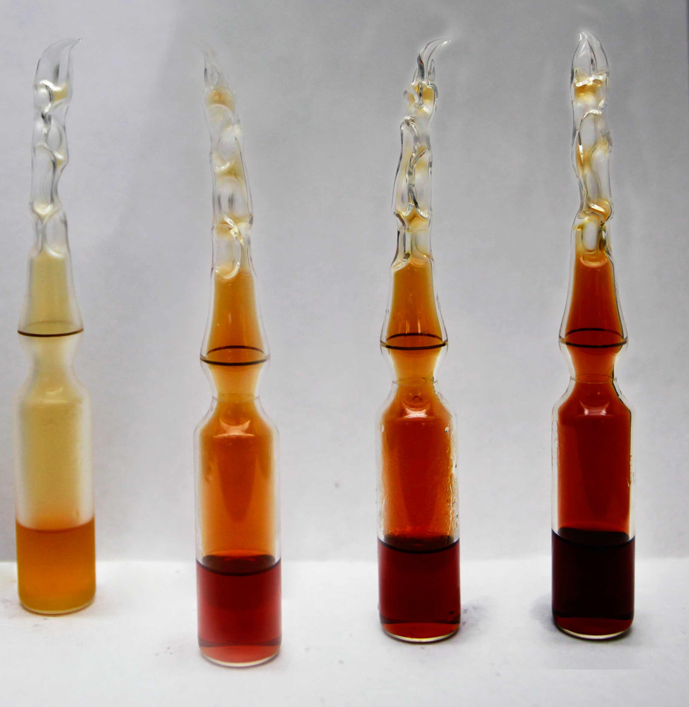
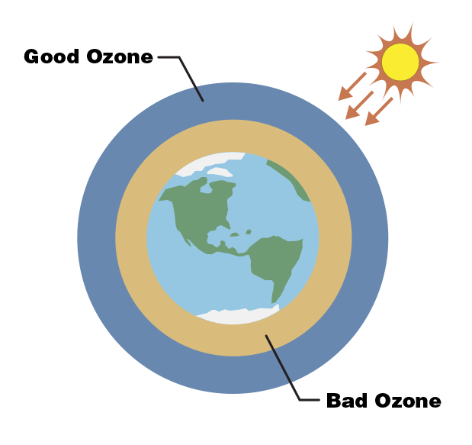
Technical Terminology
AQI Air Quality Index is used for reporting daily air quality. It is the index used for reporting air quality on a scale from 0 to 500 with 0 being good and 500 being hazardous.
Pollutants
Particulate matter (PM2.5) Fine Particulates such as sulfates, nitrates, ammonia, sodium chloride, black carbon, mineral dust and water.
Carbon monoxide (CO) Toxic gas produced by the incomplete combustion of carbonaceous fuels.
Ozone (O₃) Ozone at ground level – not to be confused with the ozone layer in the upper atmosphere – is one of the major constituents of photochemical smog and it is formed through the reaction with gases in the presence of sunlight.
Nitrogen dioxide (NO₂) NO₂ is a gas that is commonly released from the combustion of fuels in the transportation and industrial sectors.

Slide 5
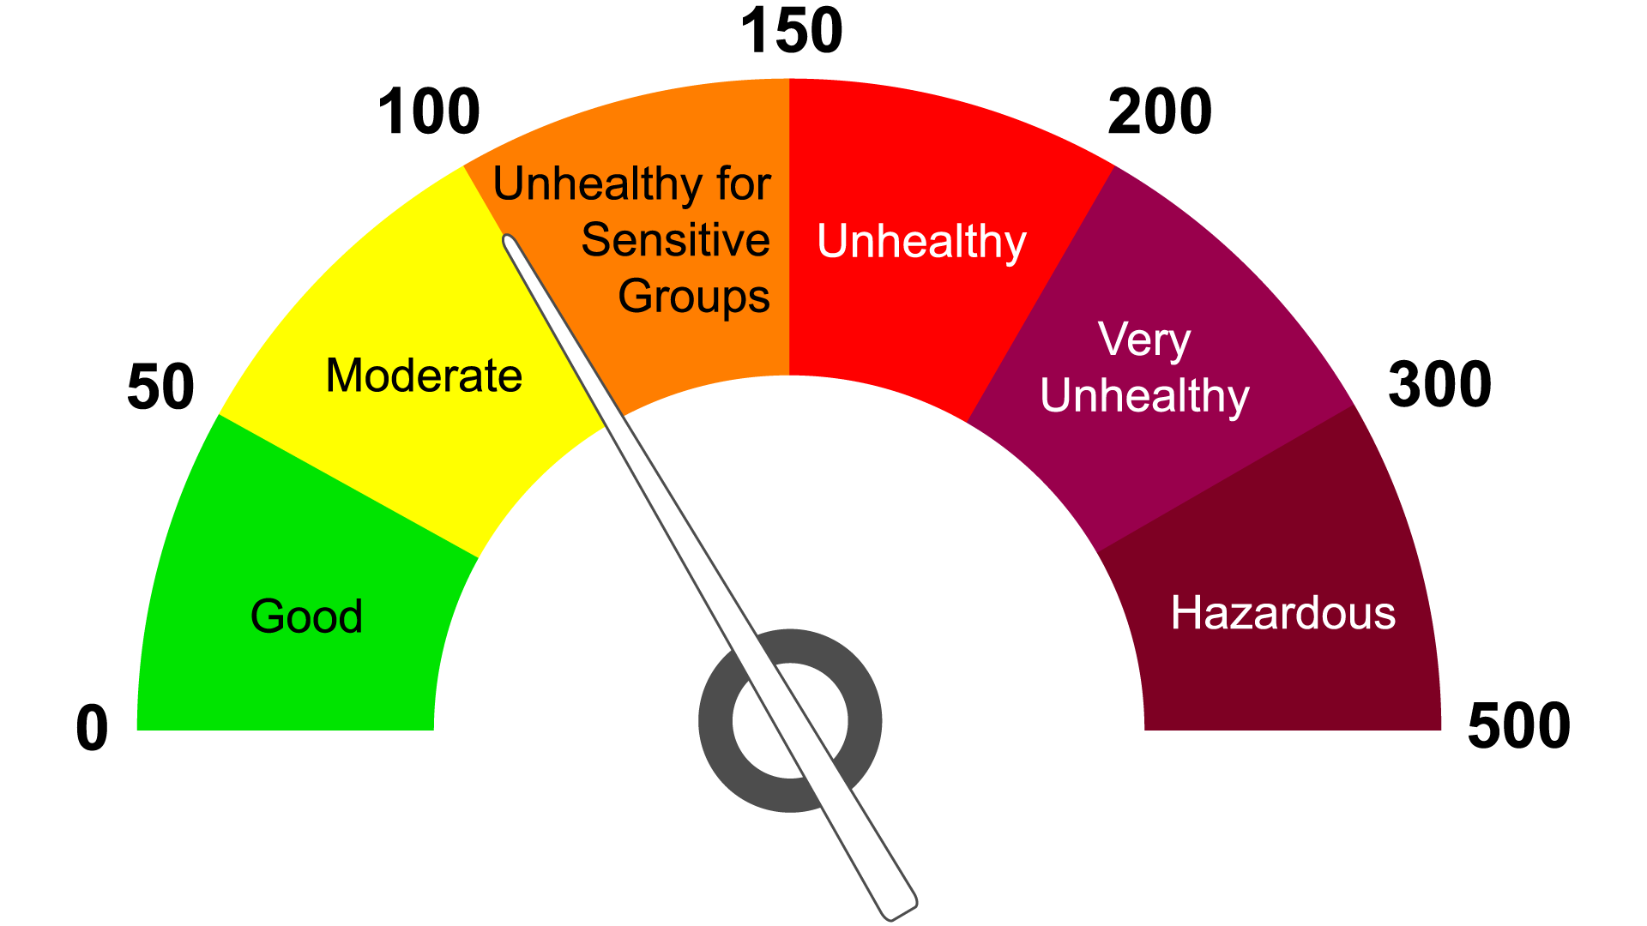
Air Quality Index

Slide 6
Data Set
 | Data Set Columns
1 | Country
2 | City
3 | AQI Value
4 | AQI Category
5 | CO AQI Value
6 | CO AQI Category
7 | Ozone AQI Value
8 | Ozone AQI Category
9 | NO2 AQI Value
10 | NO2 AQI Category
11 | PM2.5 AQI Value
12 | PM2.5 AQI Category
13 | lat
14 | lng
Overall Information
Total of 16,394 rows
This dataset is a merger of two separate datasets, one containing information about cities and their corresponding latitude and longitude coordinates. The second one containing data on air pollution levels in countries across the world.
Quality Challenges
This data set contains some incorrect latitude and longitude points that do not correspond to the country or city they are supposed to be identifying.
Last updated 9 months ago
https://www.kaggle.com/datasets/adityaramachandran27/world-air-quality-index-by-city-and-coordinates

Slide 7
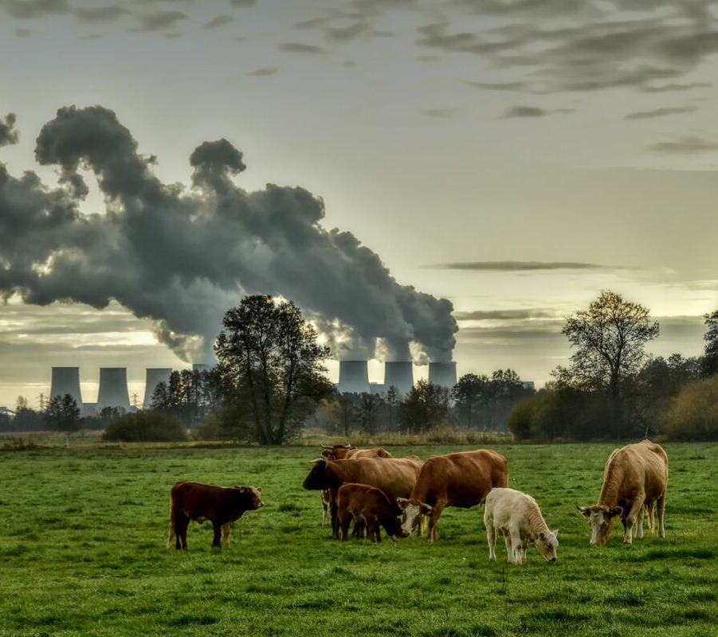
Research Questions
Which Countries have good and bad air quality ratings?
How do big cities compare with more rural areas?
What are the main pollutants affecting air quality?

Slide 8
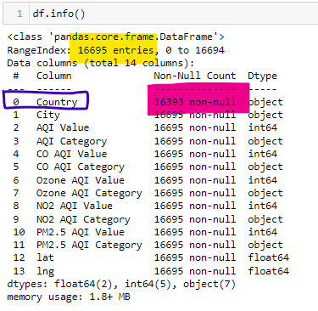

Data Prep and Clean Up
There were a total of 302 rows of data that did not have a Country associated with them and 2 null values.
These values were dropped from the data set to have more consistency within the data set.

Slide 9
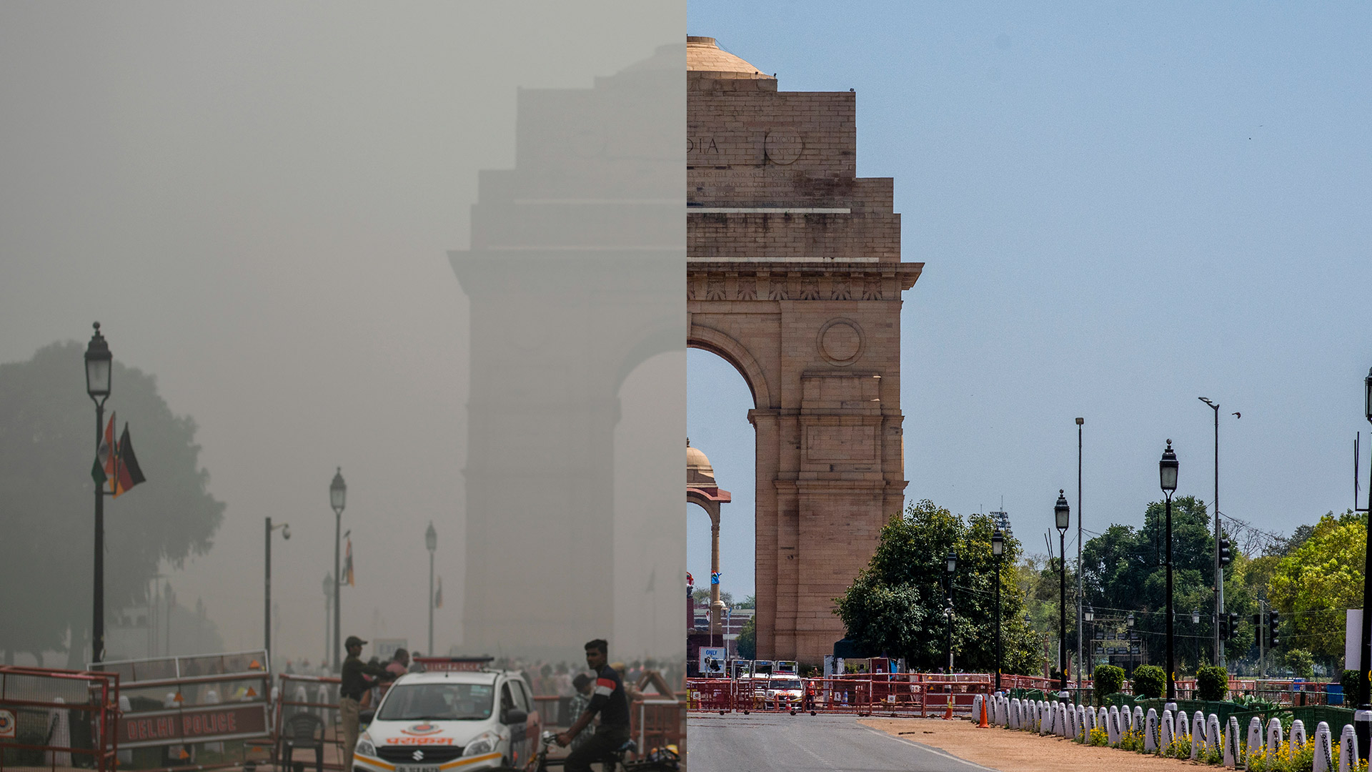
Finding #1
India is one of the countries with the worst ratings for air quality.
9 of the top 10 cities in the world with the worst ratings are in India.
40.7% of its cities fall under the “Unhealthy” category.
Multiple cities in India have AQI values of 500 which means they have “Hazardous” air quality conditions.
Despite these findings, there are a couple of cities with “Good” ratings with AQI values under 50 such as:
Port Blair (an island far from the mainland)
Chengam
Hindupur

Slide 10
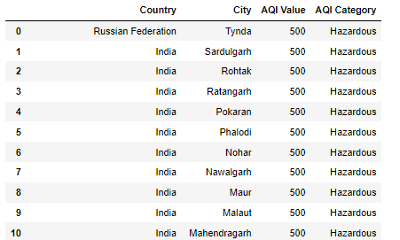
Top 10 Cities with the worst AQI values in the world

Slide 11
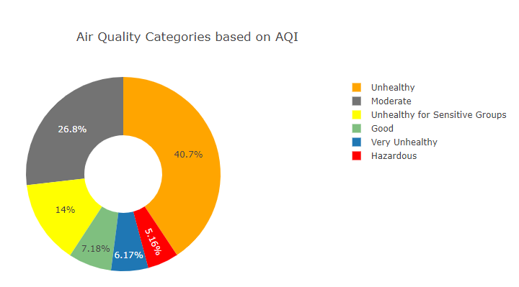
AQI - India

Slide 12
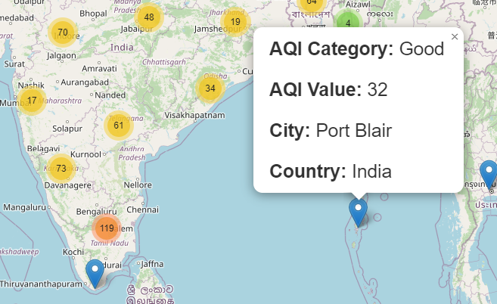
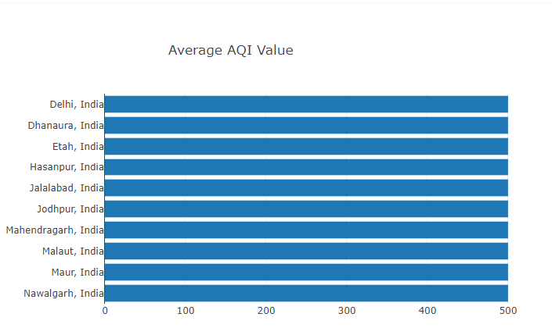
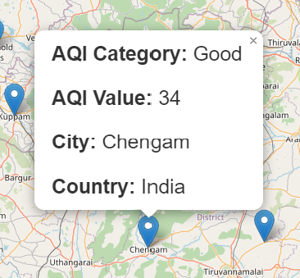
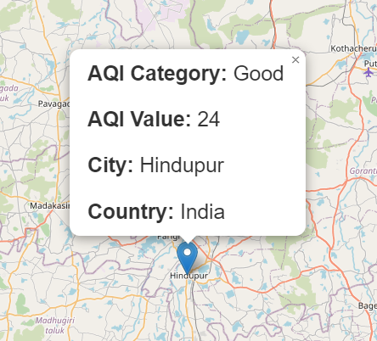
India’s Good and Bad Air Quality Cities
Good
Bad

Slide 13

Finding #2 Dallas Air Quality
Downtown Dallas has a moderate Air Quality Index value of 70.
Celina, TX (50 miles north of downtown Dallas) has a much lower AQI value of 39. This makes it fall under the “Good” air quality category.
This shows how AQI values are higher in bigger cities compared to more rural areas.

Slide 14
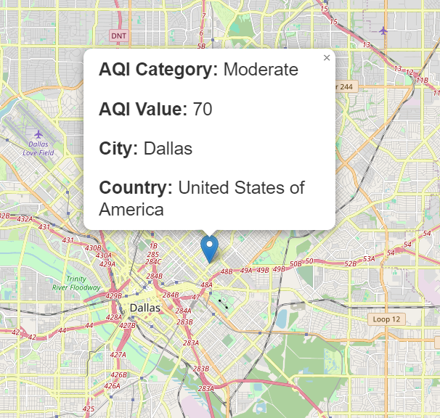

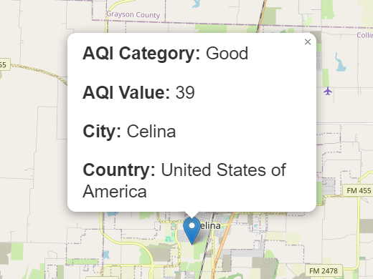

Slide 15
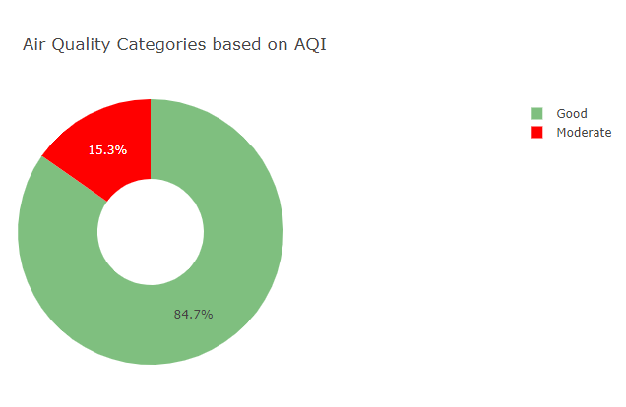
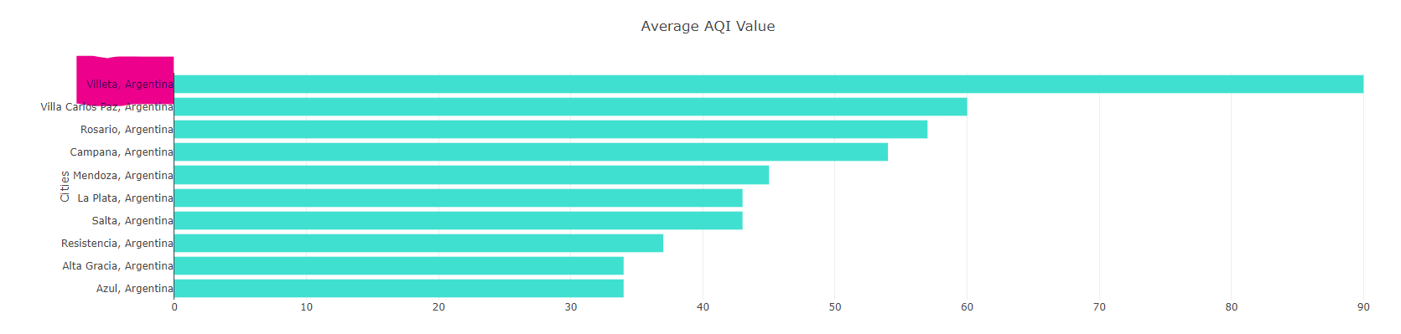
Finding #3 Argentina
84.7% of cities in Argentina fall under the “Good” air quality category.
The City with the worst AQI value rating is Villeta, which has a rating of 90 (moderate air quality).

Slide 16

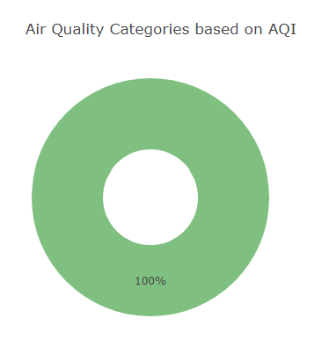
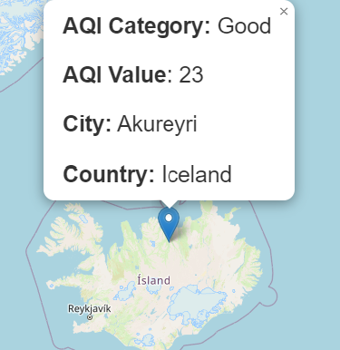

Finding #4
Iceland has ONLY “Good” air quality ratings.
This conclusion though it cannot be taken as 100% accurate since there only a single rating was reported.
More research should be taken in order to reach to the conclusion that Iceland has an overall “Good” air quality.

Slide 17

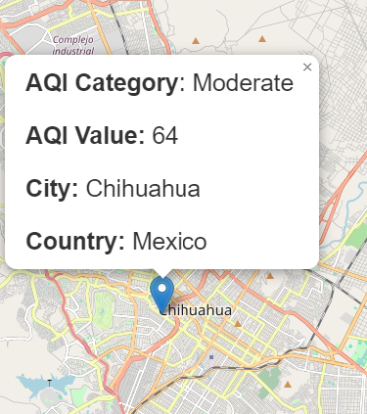
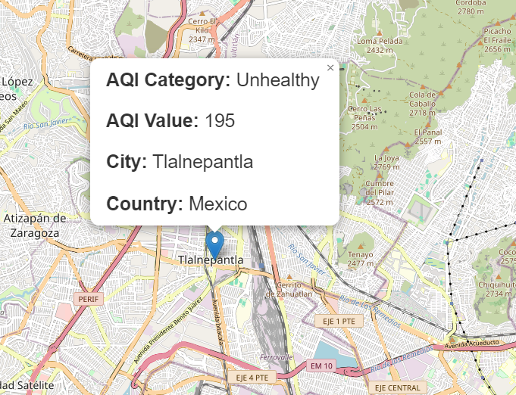

Finding #5
Chihuahua City (Misha’s hometown) has much better air quality compared to Mexico City.
Again, this proves how bigger Cities experience worse air quality compared to rural areas.

Slide 18
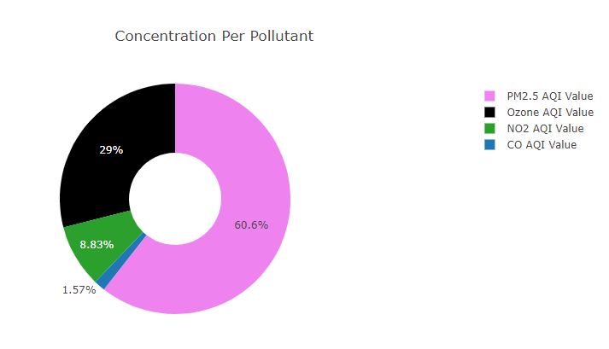
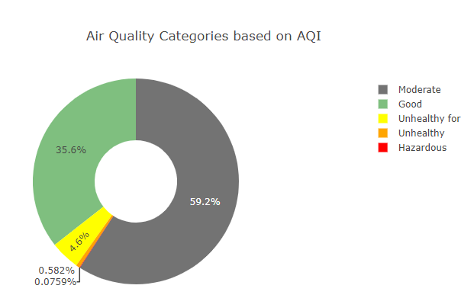

Finding #6
The United States main pollutant affecting air quality is fine particulate matter (PM 2.5) with 60.6% and it is followed by Ozone with 29%.
On average, the United States has “Good” to “Moderate” air quality.
94.8% of the ratings fall under the above two categories.

Slide 19
Dashboard Demo

Slide 20

Limitations/Bias
Not all air quality pollutants are included in this data set such as Sulfur dioxide (SO₂)
There is no date/time information therefore it is unsure if the readings are all coming from the same point in time or throughout different dates
Some Cities have multiple entries while others have single ones. A more accurate analysis could be made if all locations got the same count of readings done on the same date.

Slide 21

Future Work
Can AQI readings fluctuate during the same day?
Does temperature have an effect of AQI values?
What age range is more sensitive to bad Air Quality?
Which Country has been the most successful in improving their overall air quality?
What industries are being more proactive in implementing solutions?

Slide 22
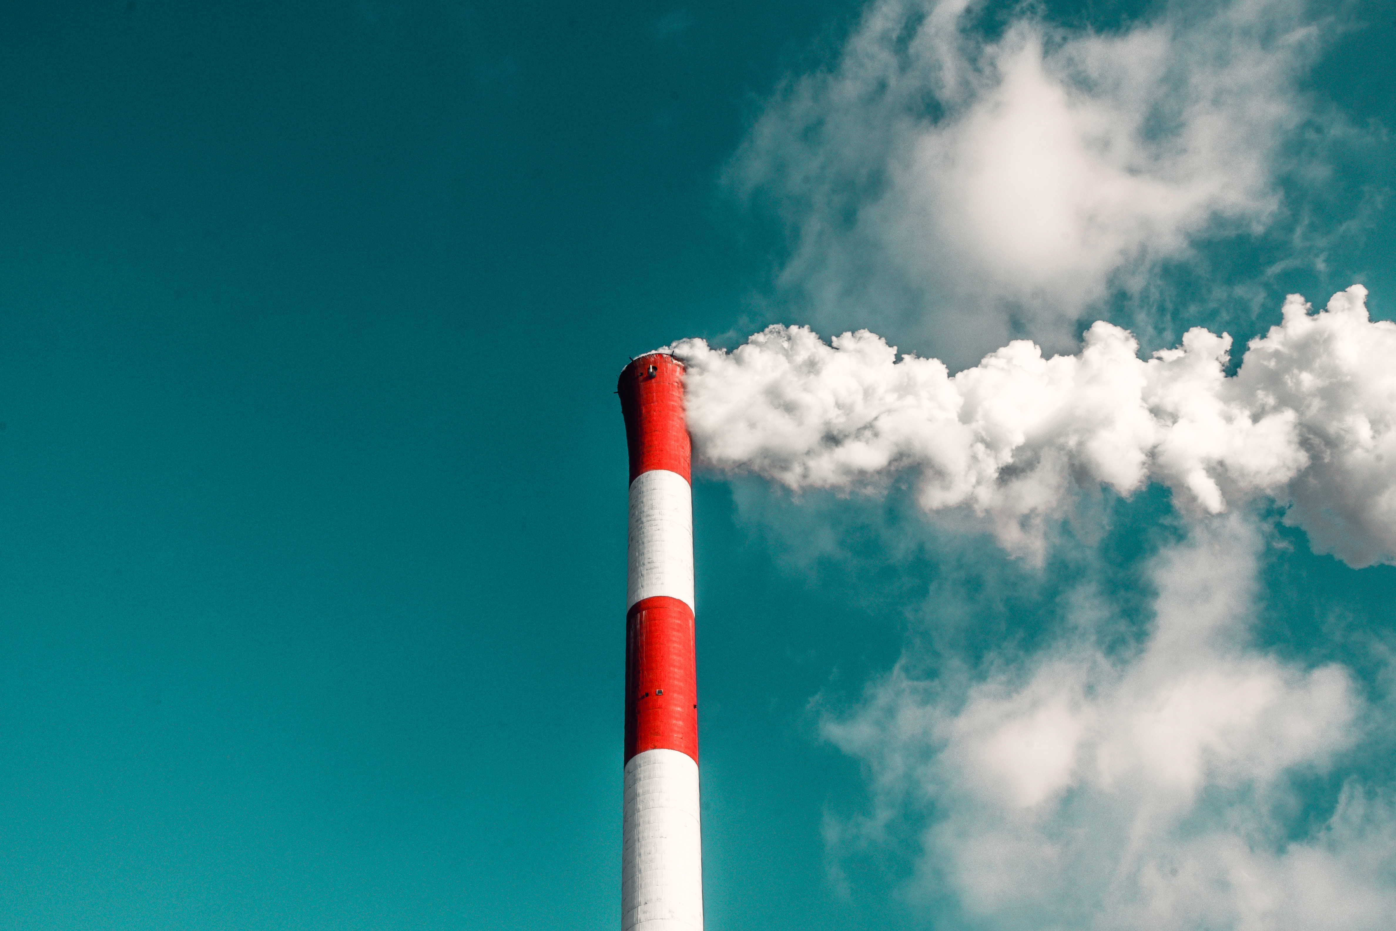
Thank You!

Slide 23

Image Links
https://www.news-medical.net/news/20230822/Can-air-pollution-shape-adolescent-brain-development-New-study-reveals-sex-specific-effects-of-PM25-NO2-and-O3-on-white-matter-microstructure.aspx
https://medium.com/mobile-development-group/lookout-air-quality-index-app-a59885eec085
https://www.lgnewsroom.com/2023/10/analyzing-and-managing-air-pollutants-to-create-better-life-for-all/
https://www.latimes.com/california/newsletter/2023-04-20/air-pollution-2023-essential-california-essential-california
https://genv.org/causes-of-air-pollution/
https://www.thelandofem.com/blog/2022/3/30/tox-in-the-land-carbon-monoxide
https://www.uia-initiative.eu/en/air-quality

Slide 24
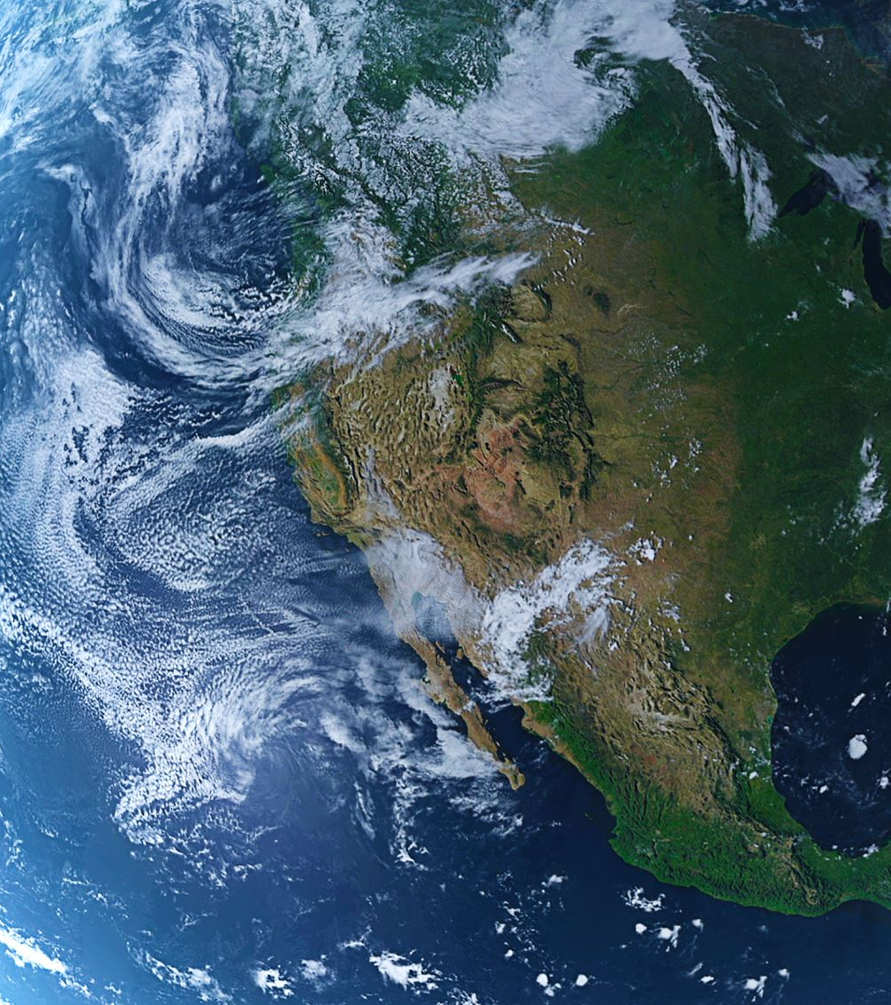
Article Links
https://www.weforum.org/agenda/2020/09/we-can-put-a-price-on-clean-air/
https://digitalprojects.davidson.edu/earthday2020/air-pollution/
https://www.deq.ok.gov/air-quality-division/ambient-monitoring/aqi-alerts-advisories/
https://www.who.int/news-room/fact-sheets/detail/ambient-(outdoor)-air-quality-and-health

Slide 25

https://www.kaggle.com/datasets/adityaramachandran27/world-air-quality-index-by-city-and-coordinates

